Slide 1
Project Abstract
Group Members
407410003 常亦德
407410065 王宸潤
408410042 林靖紳

Slide 2
Outline
Motivation
Project abstract
Introduction
Topic
Implementation
Analysis
Improvements
Notes:
Simply explain our motivation

Slide 3
Motivation

Slide 4
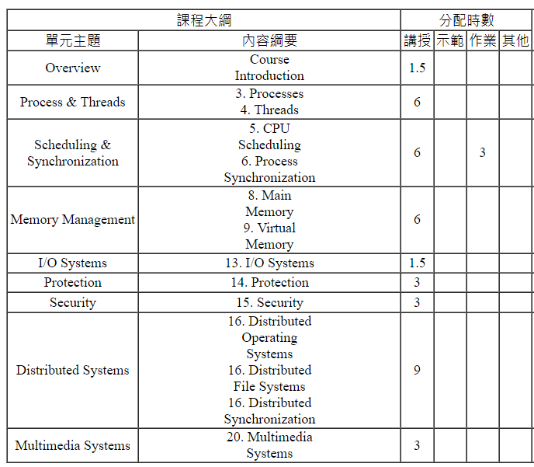
Courses Outline
Notes:
First of all, our opinions to the project is to extend what we will learn in the course According to this course outline, we read the slides on the Ecourse 2 and decided a topic to extend.

Slide 5
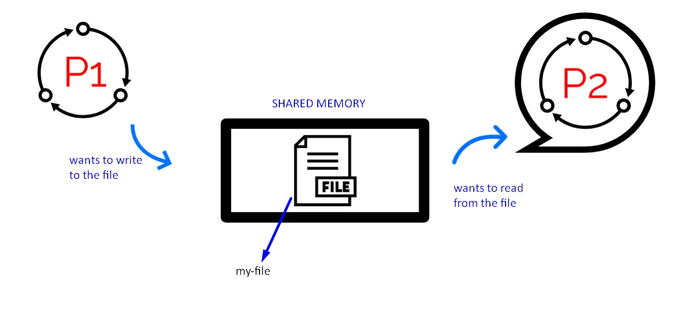
Synchronization
Resources
Notes:
Parallel or multiple threads and processes are often come into the problem of synchronization.
In “Topic 6 Synchronization”, we will learn what is race condition, critical sections problem and its solution: Peterson’s solution and locks

Slide 6
Strategies of Locks
In Linux kernel, the strategies of lock can mainly divided into two part:
Spinning
Blocking (sleeping) lock
Make thread sleep until the lock is free
and then put it back into run queue
Notes:
In Linux kernel, the strategies of locks can mainly divided into two part: spinning and blocking (sleeping) lock.
In topic 6 slides it introduce the blocking strategy: Mutex and Semaphore
which make thread sleep until the lock is free and then put it back into run queue.

Slide 7
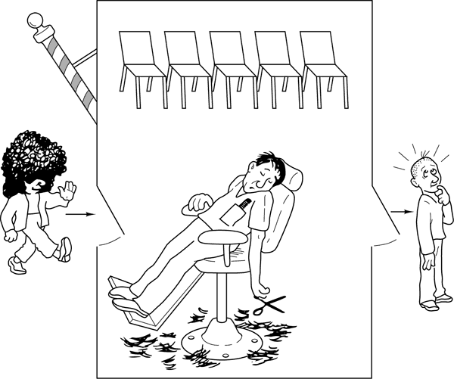
Sleeping Locks
Resource
Notes:
Sleeping locks are suitable for locks that are held in a longer periods; however, the overhead of context switching and dispatching as well as the consequent increases in cache miss.

Slide 8

Spinlock
Therefore, we will introduce another lock: Spinlock
Resources

Slide 9
Abstract

Slide 10
Introduction
Notes:
We will simply introduce/describe the race condition and crtitical section before the spinlock

Slide 11
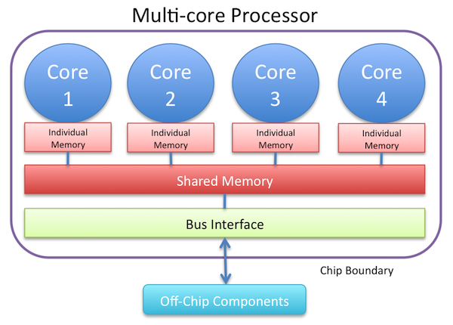
Multi-core Systems
Resources
Notes:
As the number of multi-core systems increases, more processes or threads execute simultaneously on different cores.
When multiple processes execute the same code or access same memory or any shared variable in this situation,
the output or the value of the shared variables will probably be wrong

Slide 12
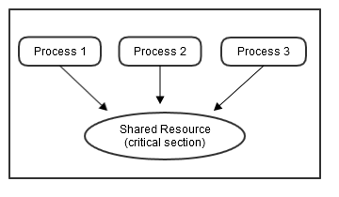
Race Condition
Resources
Notes:
however, all the processes doing the race return that their output value are correct. This is so called race condition.

Slide 13
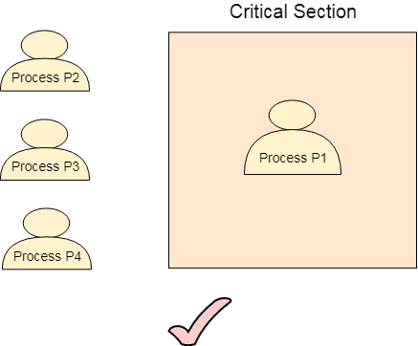
Critical Section
Resources
Notes:
A race condition may occur inside a critical section,
where only one process is allowed to access the code segment at a time,
Therefore, critical section problem means that we should designing a way to
access shared resources for cooperative processes without creating data inconsistencies.

Slide 14
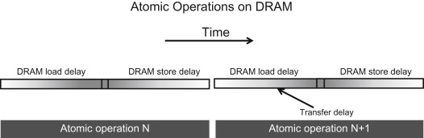
Atomic Operations
Resources
Notes:
Most of shared memory multiprocessor architectures provide hardware support for making mutually exclusive accesses to shared data structures.
This support usually consists of instructions that atomically read and then write a single memory location

Slide 15

Busy Waiting
Resources
Notes:
These atomic operations are used to manipulate locks;
when a processor is accessing a data structure, the lock is busy, so other processors requesting access must wait,
also called as “busy waiting.”

Slide 16
Topic

Slide 17
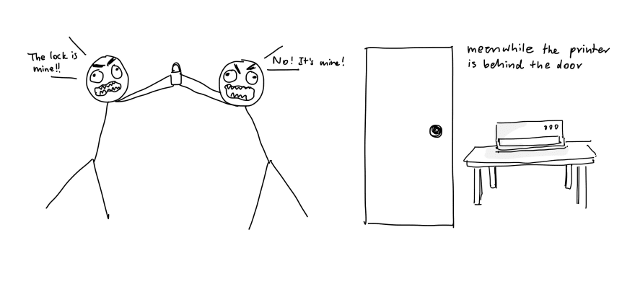
Spin lock
Resources
Notes:
For small critical sections, spinning for a lock to be released is more efficient than relinquishing the processor to do other works;
however, its overhead is spin-waiting will slow down other processors by consuming communication bandwidth.

Slide 18
Work division
Implementation
Analysis
Improvement
Notes:
Implementation
Implement spinlock in C language
Design a testing structure for analyzing its efficacy
Analysis
Record and aggregate the data and compare the data with other locks
Analyze pros and cons of Spinlock, and discuss under which circumstances would lead to the outcome
Improvement
Based on the results of our analysis, try to make some improvements to our Spinlocks code
Try to optimize the overhead of cores communication bandwidth

Slide 19
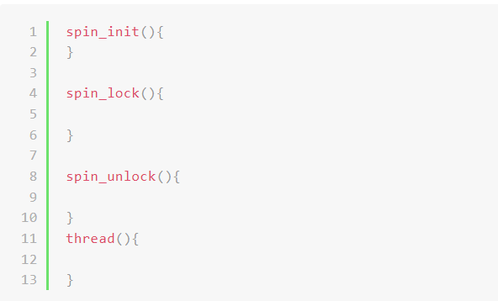
Implementation
Implement spinlock in C language
Design a testing structure for analyzing its efficacy

Slide 20
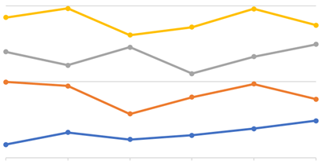
Analysis
Record and aggregate the data and compare the data with other locks
Analyze pros and cons of Spinlock, and discuss under which circumstances would lead to the outcome

Slide 21

Improvement
Based on the results of our analysis, try to make some improvements to our Spinlocks code
Try to optimize the overhead of cores communication bandwidth
Resources

Slide 22
Thanks for listening

